Slide 1
Understanding Cross-Cultural Psychology

Slide 2
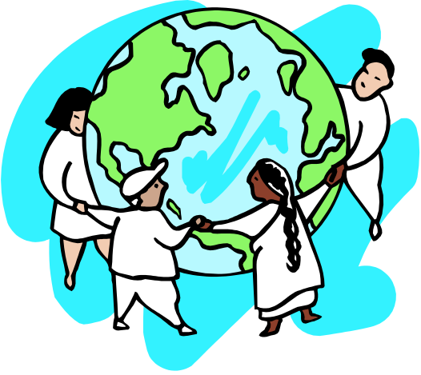
If we could, at this time, shrink the Earth’s population to a village of precisely 100 people, with all existing human ratios remaining the same, it would look like this:
There would be--
14 from the Western Hemisphere (North and South), and
8 Africans.
70 would be non-white.
70 would be non-Christian.
50% of the world’s wealth would be in the hands of only 6 people
All 6 would be citizens of the United States.
70 would be unable to read.
50 would suffer from malnutrition.
80 would live in sub-standard housing.
Only 1 would have a college education.
Notes:
Video

Slide 3
Basic Definitions
Culture:
A program of shared rules, attitudes, values, and beliefs that govern the behavior of the majority of community members communicated from one generation to the next.
Culture can be defined as the shared rules that govern behaviour and that define our day t day reality. It is a broad term that underlies basic attitudes, values, beliefs and behaviour's that are shared between members of that culture. Culture is not static, it changes. It is reasonable stable from one generation to the next, however, attitudes and values do change even if slowly.

Slide 4
Sense of community
Sense of community, or psychological sense of community, is a concept in community psychology and social psychology, which focuses on the experience of community rather than its structure, formation, setting, or other features.

Slide 5
McMillan & Chavis (1986)
McMillan and Chavis (1986) define the sense of community as "a feeling that members have of belonging, a feeling that members matter to one another and to the group, and a shared faith that members' needs will be met through their commitment to be together.“
McMillan & Chavis's (1986) theory is the most broadly validated and widely utilised in this area in the psychological literature. They prefer the abbreviated label "sense of community", and propose that sense of community is composed of four elements.

Slide 6
Four elements of ‘sense of community’
Membership
Membership includes five attributes: boundaries, emotional safety, a sense of belonging and identification, personal investment, and a common symbol system
Influence
Influence works both ways: members need to feel that they have some influence in the group, and some influence by the group on its members is needed for group cohesion. Current researches (e.g. Chigbu, 2013) on rural and urban communities have found that sense of community is a major factor in development.
Integration and fulfilment of needs
Members feel rewarded in some way for their participation in the community.
Shared emotional connection
The "definitive element for true community", it includes shared history and shared participation (or at least identification with the history).

Slide 7
Types of Cultures
Fijeman et al (1996)
  Collectivist cultures contribute to others & so support them back i.e., interdependence (to facilitate group harmony)
  Individualist cultures expect to contribute less to others & tend not to expect support back i.e., independence (to facilitate competition)

Slide 8
Collectivism vs Individualism
Triandis, 1989
Behaviour based on
  Concern for others
  Care for traditions & values
  Prefer harmony in conflict resolution
  Found in Asian & former communist countries
Behaviour based on
  Concern for self & one’s primary group
  Prefer competitive strategies
  Found in Western countries

Slide 9
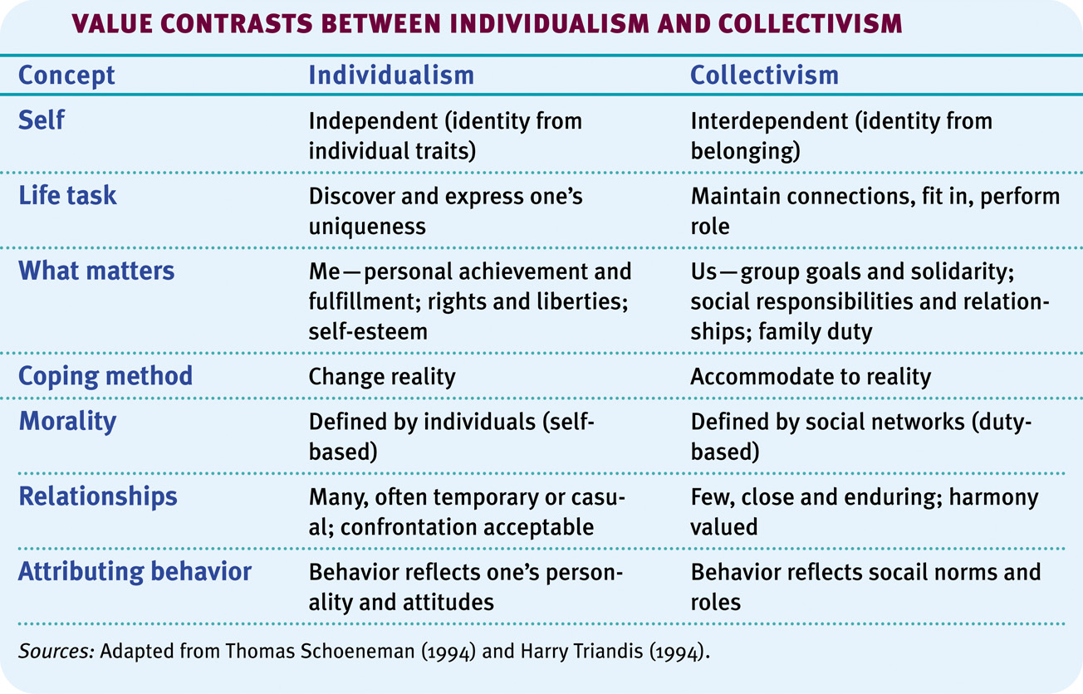
Culture and the Self

Slide 10
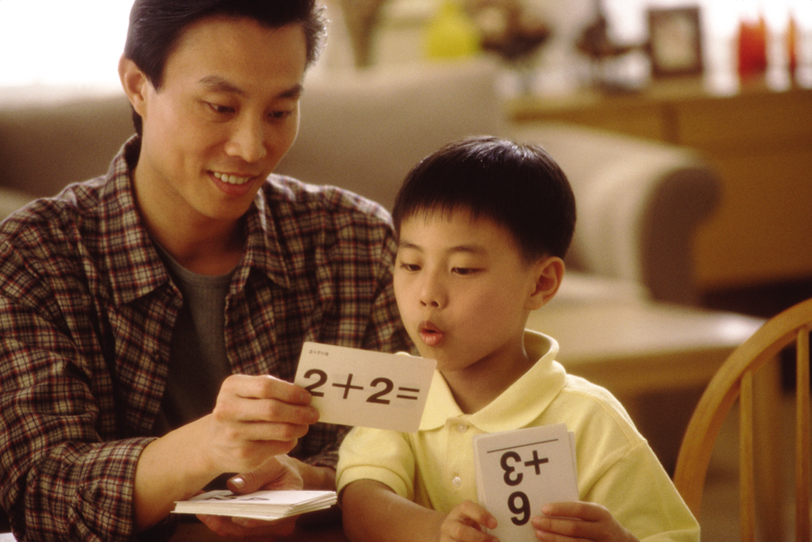
Culture and Child-Rearing
Individualist cultures (European) raise their children as independent individuals whereas collectivist cultures (Asian) raise their children as interdependent.
Westernised Cultures | Asian-African Cultures
Responsible for your self | Responsible to group
Follow your conscience | Priority to obedience
Discover your gifts | Be true to family-self
Be true to yourself | Be loyal to your group
Be independent | Be interdependent
Notes:
OBJECTIVE 23| Describe some ways that child-rearing differs in individualist and collectivist cultures.

Slide 11
Cultural Influences
Culture can influence our behaviours. For example how we raise our children and eat our food. Whether we wear clothes, and how we wear them. What festivals we celebrate and how much space we need between us and others to feel comfortable. It can also effect the type of treatment we choose to get when sick. It effects us through social norms and rules of our group, and therefore has an influence on our attitudes towards others, object and events.
Ecological Factors
• geography, climate, natural resources
Social Factors
• population density, affluence, technology, government, media, religion
Biological Factors
• temperament, personality

